Slide 1



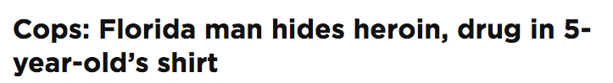
Using report cards to enhance environmental intelligence
Bill Dennison
University of Maryland Center for Environmental Science

Slide 2
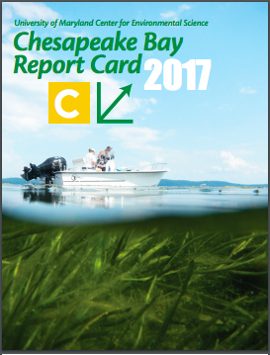
What is environmental intelligence?
The ability to acquire and apply environmental knowledge.
The collection of information of environmental value.
Environment is derived from a French word ‘environ’ (surrounding)
Intelligence is derived from a Latin word intelligere (to comprehend or perceive)
3. The ability to perceive your surroundings.

Slide 3
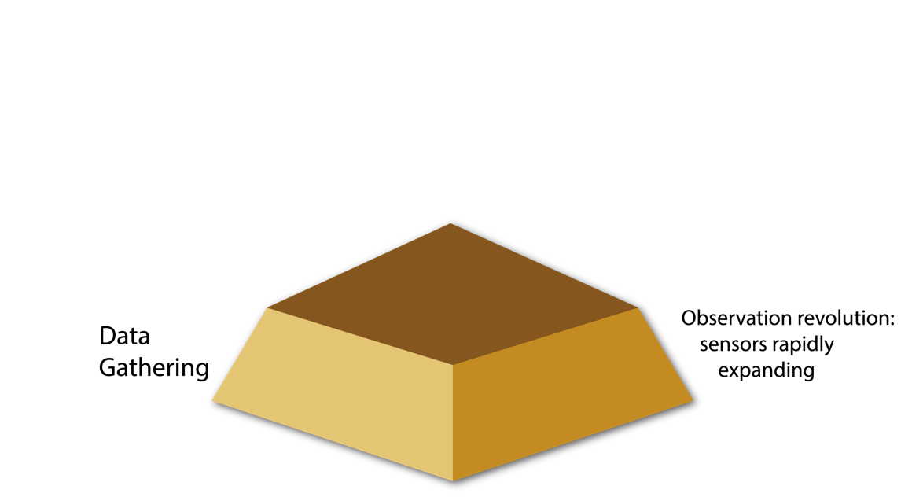
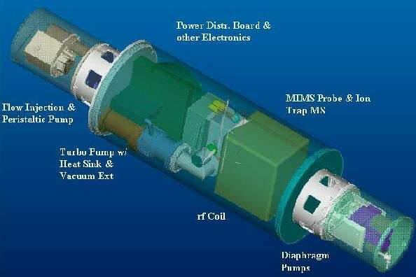
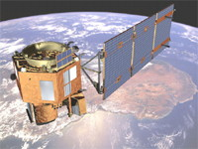
Observation revolution: Sensors rapidly expanding

Slide 4
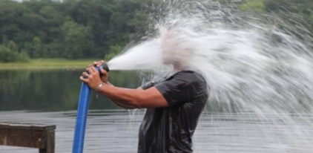
Observation revolution: Sensors rapidly expanding

Slide 5
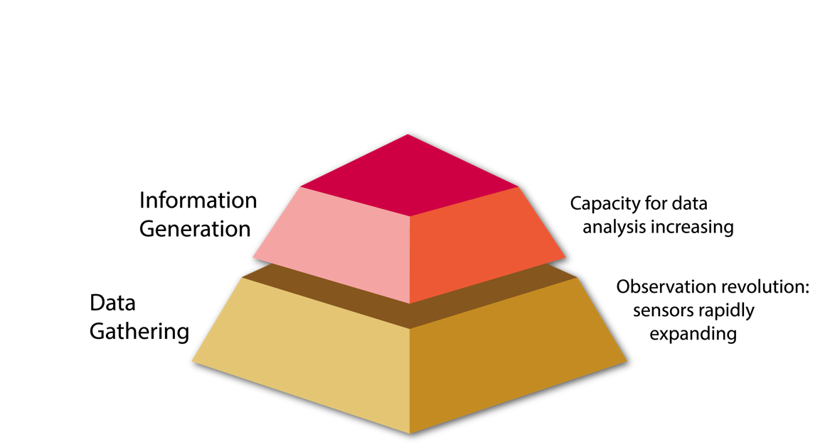
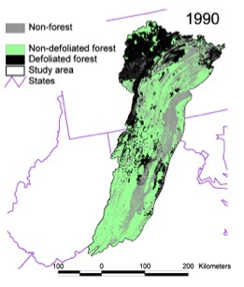
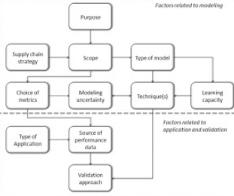
Capacity for data analysis increasing

Slide 6
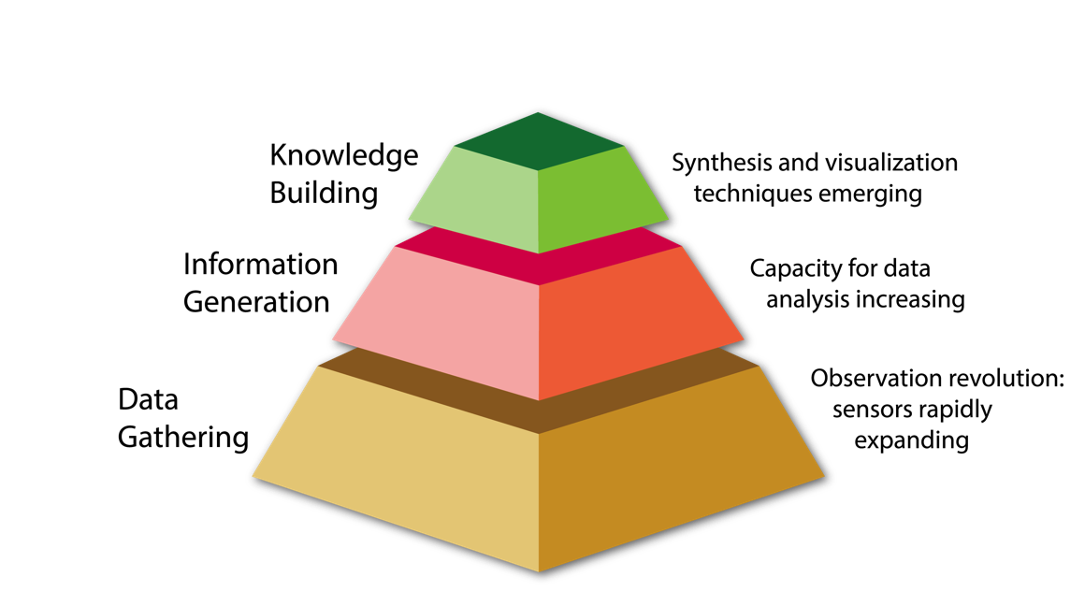


Synthesis and visualization techniques emerging

Slide 7
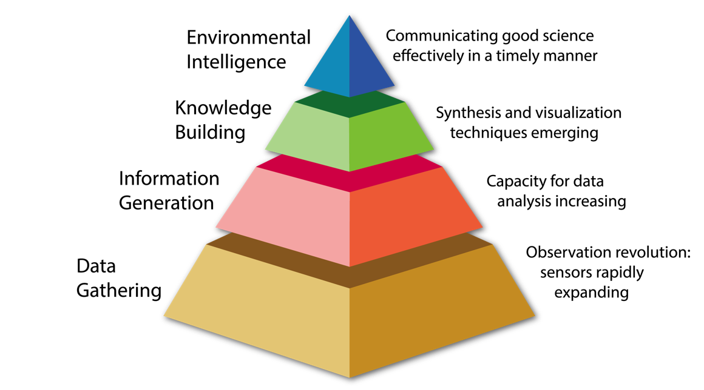
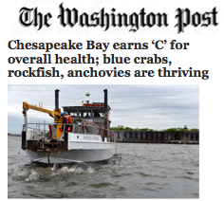
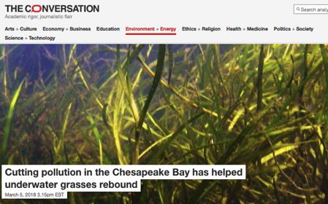
Communicating good science effectively in a timely manner

Slide 8
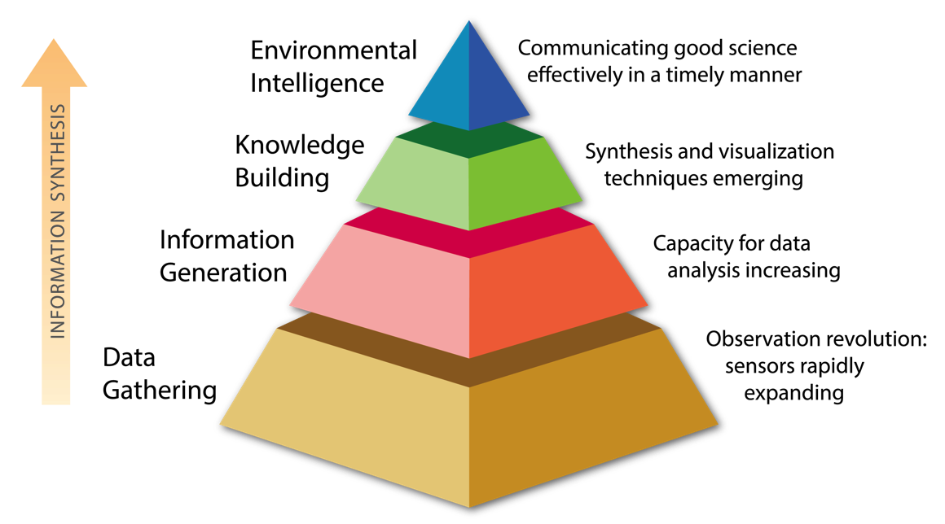
Environmental intelligence pyramid

Slide 9
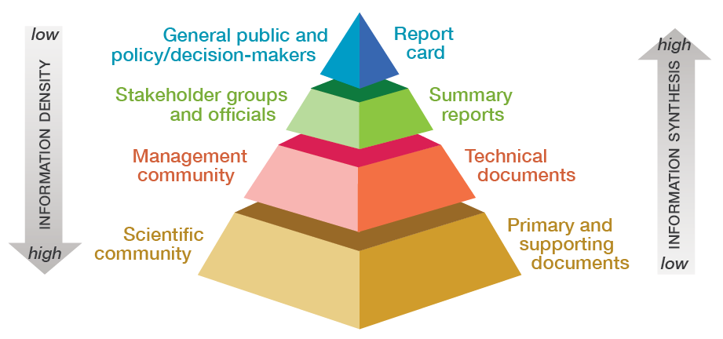
Report cards create environmental intelligence

Slide 10
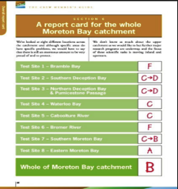
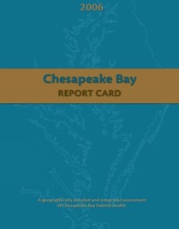
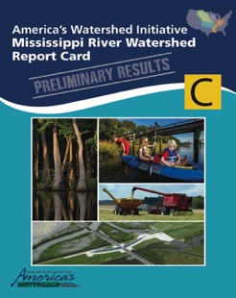
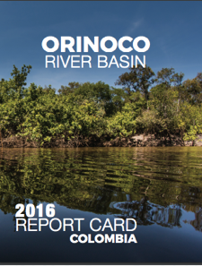
The report card journey
1998 In the beginning: Moreton Bay
2006 Telling the story: Chesapeake Bay
2015 Expanding the size and scope: Mississippi River
2016 Capacity building: Orinoco River, Tuul River
Future Integrating socio-economic with ecological aspects

Slide 11
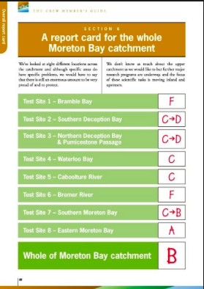
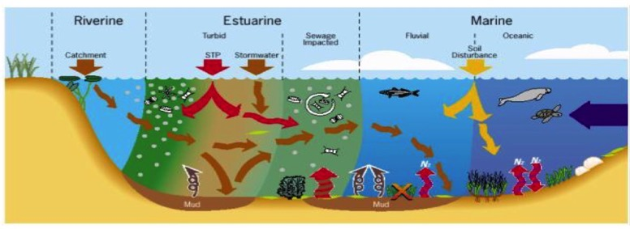
Moreton Bay – initially qualitative
“There is something fascinating about science. One gets such wholesale returns of conjecture out of such a trifling investment of fact.” Mark Twain

Slide 12
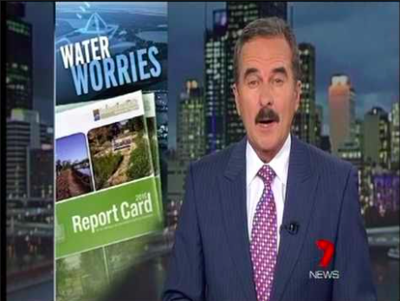

Generated significant local media attention

Slide 13
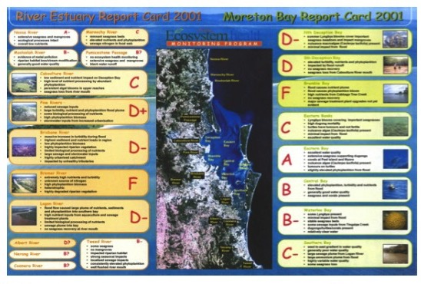
Developed a rigorous report card framework

Slide 14
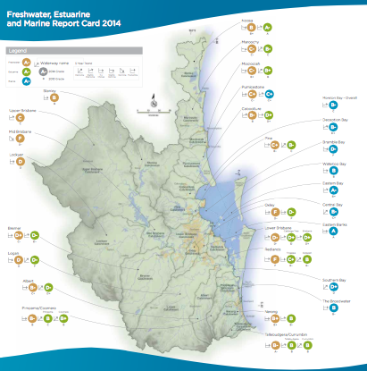
Report card expanded geographically

Slide 15
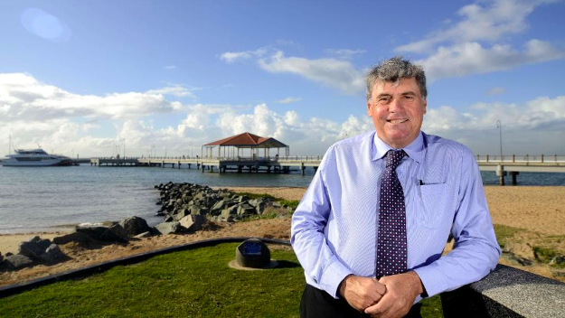
Moreton Bay Council Mayor Allan Sutherland

Slide 16
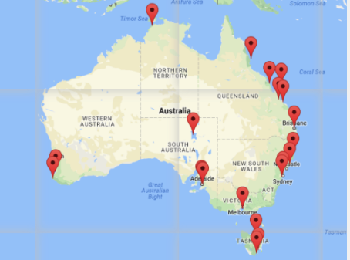
Report cards expanded throughout Australia

Slide 17

Brisbane Lord Mayor Jim Soorley

Slide 18
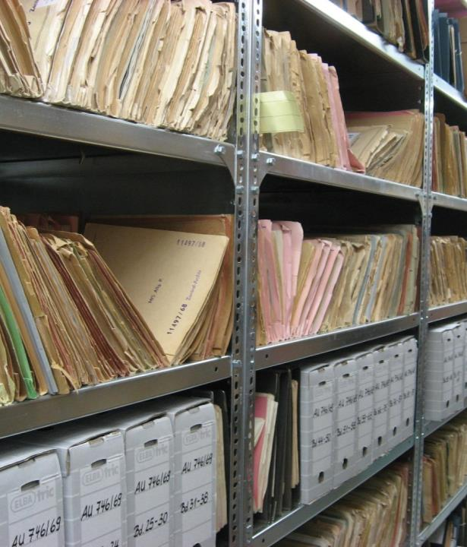
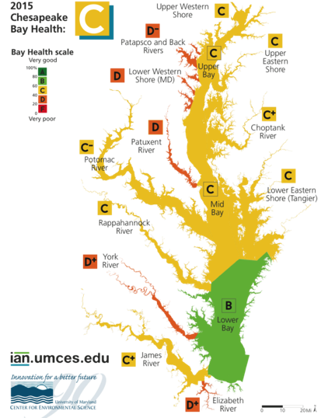
Chesapeake Bay: Data rich but synthesis poor

Slide 19
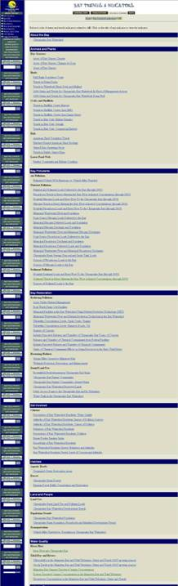
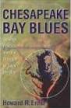
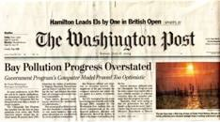
Chesapeake Bay Program indicators
In 2005, there were 101 indicators; mixed ‘state’ and ‘response’ indicators
No hierarchy or combined indices; No stories
Conflicting stories: “Happy Talk” vs. “Doom and Gloom” about perceived progress
Chesapeake Bay Program indicators as they appeared on the website

Slide 20
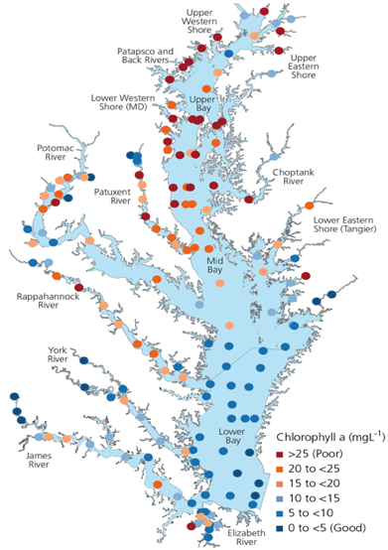
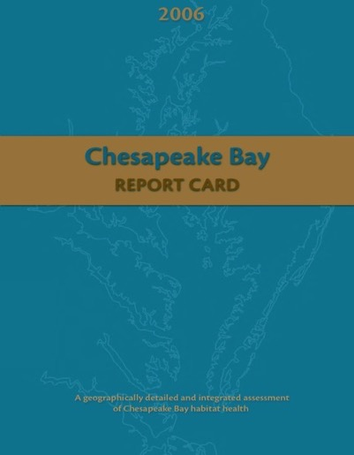
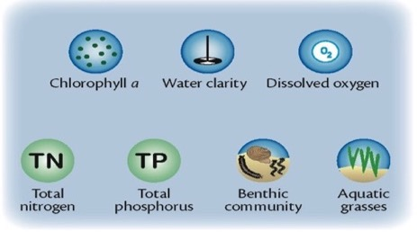
Initial Chesapeake Bay report card produced in 2006

Slide 21
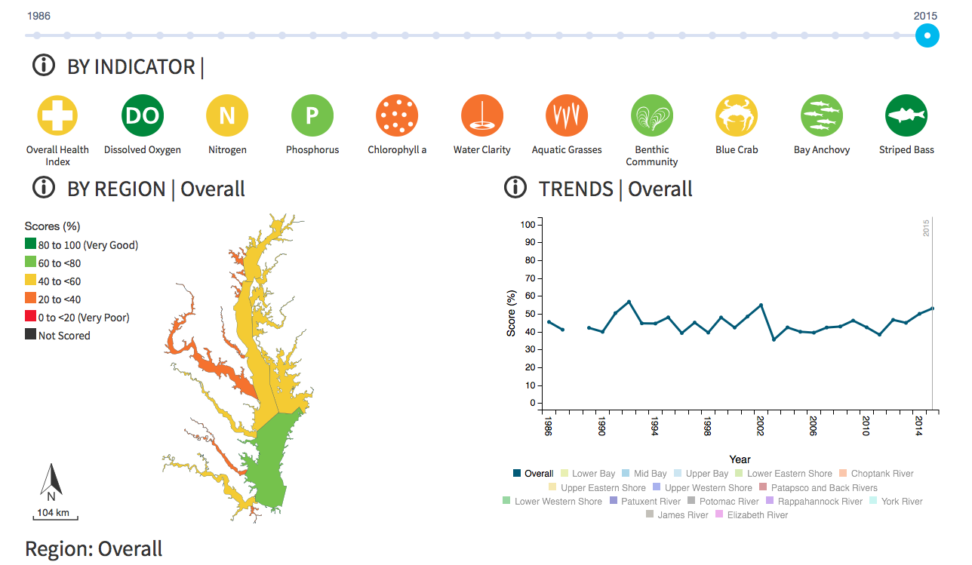
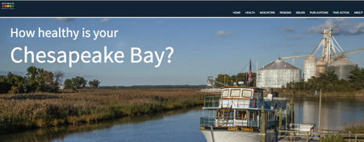
Report card website created www.ecoreportcard.org

Slide 22
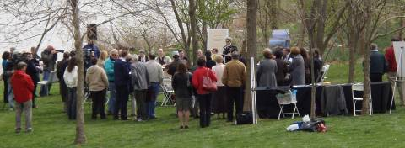

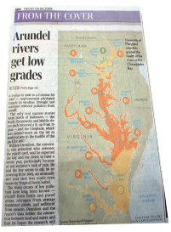
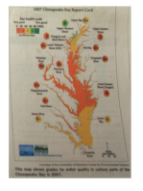
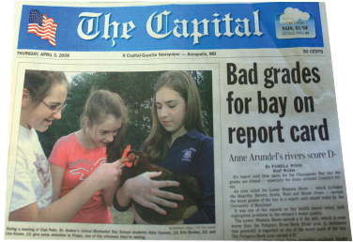
Chesapeake Bay report card generates media attention
Report card media reach
2016
Associated Press 24 M
CNN 29 M
Print/on-line media 40 M
Broadcast media 31 M
TOTAL 124 M

Slide 23
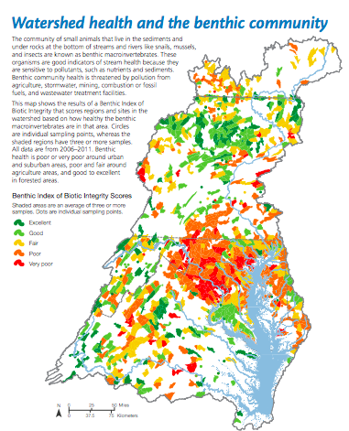
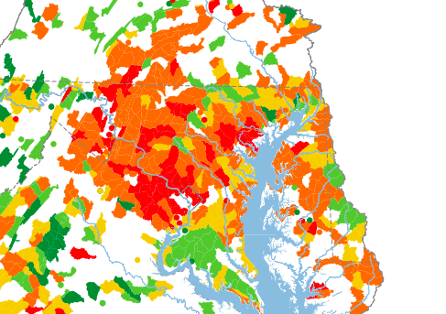
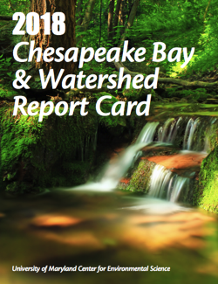
Chesapeake watershed health; stream benthic macroinvertebrates

Slide 24

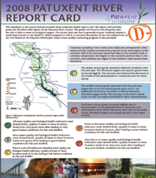
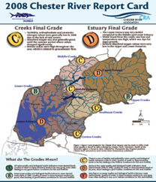
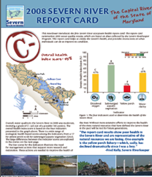
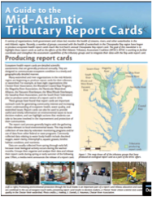
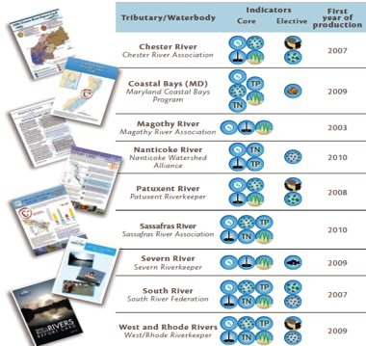
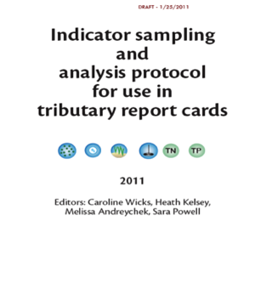
Citizen scientists conducting regional environmental monitoring

Slide 25
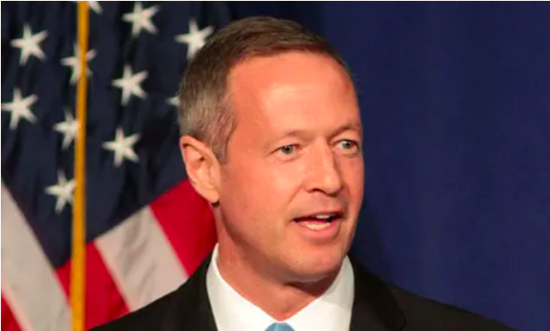
Maryland Governor Martin O’Malley

Slide 26







Mississippi River basin is large with multiple goals

Slide 27

Multiple regional workshops

Slide 28



Draft report card scores

Slide 29


Feedback solicited at Mississippi River Summit
Draft report card published
Methods paper accompanying report card
Extensive feedback solicited (Conversant)
Report card revision initiated

Slide 30



Final report card

Slide 31


We have used the report card approach with National Park Service

Slide 32

Conceptual diagrams used to establish indicators
Notes:
Discuss: Size of sediment arrows, colour of water, and number (or biodiversity) of fish.

Slide 33




Conceptual diagrams use symbols to depict unequivocal messages
Darwin’s diagram
Cave painting
Notes:
Compare this Australian Aboriginal cave painting to Charles Darwin’s atoll diagram. Both of these were created in the 18th century, and both are undoubtedly referring to the same thing.

Slide 34




Symbols are language independent and universal
Symbols can represent something tangible
Symbols can represent something invisible or intangible

Slide 35


IAN is creating a global symbol language
236 countries 2953 symbols
Over 96,000 registered users
Notes:
We’ll be teaching you how to use this resource later today…

Slide 36


Partnership with WWF launched
Notes:
So we teamed up with the WWF pandas
And we figured out what our brand is
We combined our different strengths
And we even went to great lengths
To make our partnership somewhat formal
Calling ourselves Healthy Rivers for All.

Slide 37

Re-imagining the report card process
Report card process includes:
Stakeholder assessment
Balance in social and environmental concerns
A new focus on looking forward

Slide 38





Stakeholder driven process

Slide 39



Incorporating cultural resources in report cards

Slide 40














Ten regional report cards also produced

Slide 41


10 sub-basins

Slide 42


Pressure – State – Response approach

Slide 43

Tennessee River report card

Slide 44

Published Practitioner’s Guide

Slide 45

Surveyed report card practitioners

Slide 46

Tuul River, Mongolia report card

Slide 47



The Tuul River is in northcentral Mongolia

Slide 48



The Tuul River watershed has increasing livestock populations tended by traditional nomadic herders.

Slide 49



The Tuul River and the people residing in the watershed are particularly vulnerable to climate change.

Slide 50

Tuul River indicators

Slide 51

Tuul River report card

Slide 52

Tuul River report card

Slide 53

Report cards Bring key stakeholders together

Slide 54

Report cards merge multiple knowledge streams and different value systems to co-create new knowledge.

Slide 55


How to make an ecosystem health report card course
Notes:
Last week we started teaching a report card class
So that we can share our knowledge en masse
We will post the lectures on our YouTube channel
And talk with our student using a Bluejeans panel
The students will summarize the classtime conversations
And post a blog that we share with many nations.

Slide 56

Global network of practitioners established

Slide 57

The report card process is really 3 distinct phases

Slide 58



Raise the grade

Slide 59
RAMS: Resource assessment for management strategies

Slide 60
Building environmental intelligence with report cards
Report cards should be:
Transparent
Holistic
Stakeholder driven
Transdisciplinary

